Slide 2
IC Level Communications
SPI & I2C
Notes:
SERIALE ++semplice da usare, no clock
punto punto
più lenta MA più lunga

Slide 3
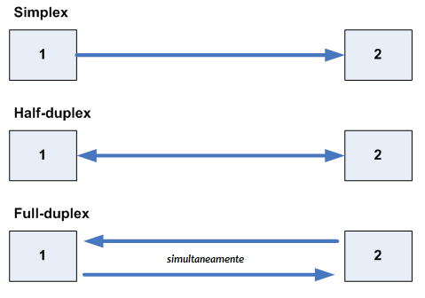
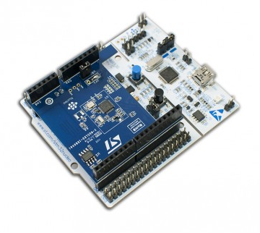
SERIAL PERIPHERAL INTERFACE
The Serial Peripheral Interface (shortened in SPI) is a syncronus, full duplex, serial communication protocol.
It uses a master-slave architecture with a single master.
STM32 Nucleo with BlueNRG Shield
Notes:
the communication is simultaneously bi-directional, data can flow from master to slave and from slave to master at the same time on two separate wires at the same time
SPI
veloce
master-slave
immunutà al rumore (chpol fronti)

Slide 4
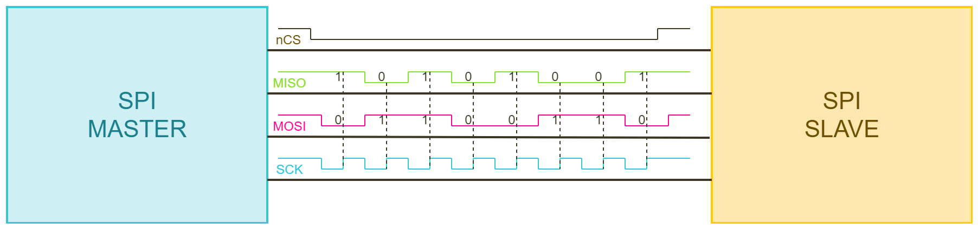
SINGLE MASTER SINGLE SLAVE
Notes:
the SPI could be used to…
the communication starts with the master lowering the chip select…

Slide 5
SERIAL PERIPHERAL INTERFACE
The clock signal is generated by one of the endpoint and provided to the others through a specific line (CLK).
The one which generates the clock is named Master while the other Slaves.
The SPI requires two data lines:
The Master Output Slave Input, often shorted as MOSI or SDO which stands for Serial Data Output.
The Master Input Slave Output, often shorted as MISO or SDI which stands for Serial Data Input.
The SPI communication uses an additional wire (nCS) for each slave to address them.
Notes:
the communication is simultaneously bi-directional, data can flow from master to slave and from slave to master at the same time on two separate wires at the same time

Slide 6
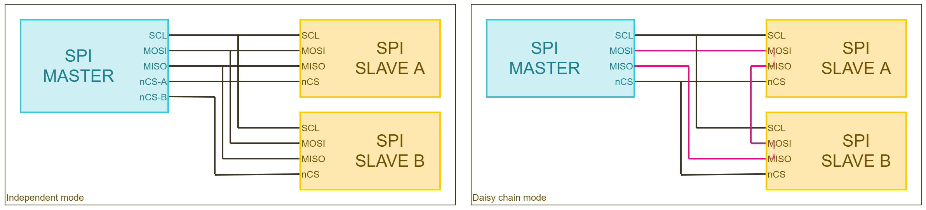
SINGLE MASTER MULTIPLE SLAVE

Slide 7
CHIBIOS SPI DRIVER: INTRODUCTION
The ChibiOS SPI driver exploits the SPI cell capabilities to offer:
Full duplex and simplex API
Synchronous and asynchronous communication API
Each API of the SPI Driver starts with the prefix “spi”. Function names are camel-case, pre-processor constants uppercase and variables lowercase.
The whole driver subsystem can be enabled through the proper switch in the halconf.h (HAL_USE_SPI).
To use the driver we have then to assign a SPI peripheral acting on mcuconf.h.
Assigning a peripheral to the driver a new object (SPIDx) will become available.
Each SPIDx object represent a driver which implements a Finite State Machine.
Notes:
Remember: only master mode!
that there are some certitudes in ChibiOS, consistency

Slide 8
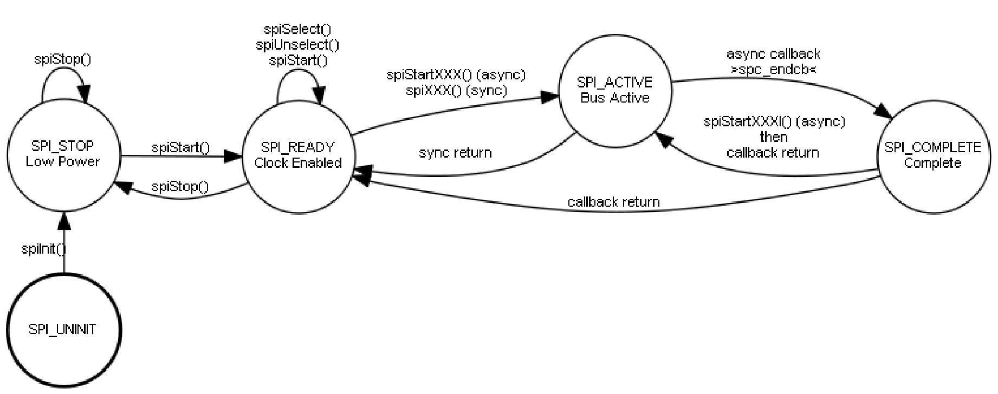
CHIBIOS SPI DRIVER: INTRODUCTION
A driver to be used shall be initialized but this is done automatically on halInit().
Each driver operation can be done only if driver has been properly started. This requires a call to spiStart().
The spiStart(&SPID1, &spicfg) receives two parameters:
A pointer to the SPI driver object we want to start.
A pointer to a configuration structure.
If the driver is not used it can be stopped through the spiStop().

Slide 9
CHIBIOS SPI DRIVER: CONFIGURATION
The SPI configuration structure has four field:
circular, is a boolean which enables the circular mode (Buffer transmitted continuously).
end_cb, a function triggered on operation complete(e.g. when we use circular mode).
ssline|ssport, ssmask|ssport, ssline, the slave select identifier (depends on SPI_SELECT_MODE).
The last two fields depends on HW and are usually control registers.
They allows to configure clock polarity, clock phase, baudrate and datasize:
Data size, which usually is a multiple of 1 byte (e.g. 8-bit, 16-bit, 32-bit).
Clock speed, which is the frequency of main communication clock.
Clock polarity (CPOL), which specifies the logic level of the clock signal when communication bus is in idle.
Clock phase (CPHA), which specifies if data is sampled on first or second clock edge.
Notes:
The next parameters are used to identify the chip select of the slave.
Those are used in software chip select mode. As said chip select can be controlled in hardware as well as in software. When chip select is controlled by software the driver need to know which pin or mask of pins is the chip select. SPI_SELECT_MODE can be configured in halconf.h. By default, it is set as SPI_SELECT_MODE_PAD.
it can be useful to take a look to SPI demo under testhal folder

Slide 10
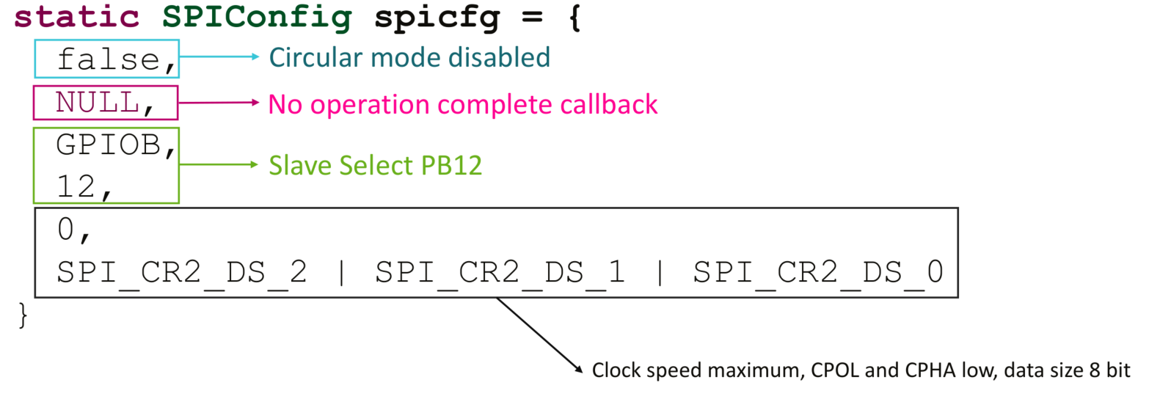
CHIBIOS SPI DRIVER: SPIv2

Slide 11
CHIBIOS SPI DRIVER: API
When started the SPI does not generate any signal.
Chip select is managed through proper APIs:
spiSelect(spip)
spiUnselect(spip)
Each communication shall be anticipated by a select and concluded with an unselect.
The SPI driver offers both synchronous and asynchronous communication functions:
spiExchange(spip, n, txbuf, rxbuf)
spiStartExchange(spip, n, txbuf, rxbuf)
Ignoring receiver or transmit buffer it is possible to do only send or transmit:
spiSend(spip, n, rxbuf)
All the functions receives a pointer to the driver (spip).
Notes:
The SPI driver offers both synchronous and asynchronous communication functions. We already introduced these concepts but let me recall them.
A blocking function blocks the execution of the calling thread until the operation is completed (synchronous functions like spiStartSend).
A non-blocking function launches the operation and returns to the calling thread which continues to be executed. Such operation is executed in the background, usually in hardware,
(asynchronous functions like spiSend).
The driver offers also a couple of API to acquire and release the bus: spiAcquireBus and spiReleaseBus. (mutex)

Slide 12
Any questions?
Raise your hand or write in the chat.

Slide 13
INTER-INTEGRATED CIRCUIT BUS
The Inter-Integrated Circuit (or I2C bus) is synchronous, half duplex serial communication peripheral bus.
It uses a master-slave architecture with a single master.
The clock signal is generated by one of the endpoint and provided to the others through a specific line (SCL).
The communication happens through a single line (SDA), it often called two-wire serial in contrast to the four-wire one (the SPI).
A transaction is composed by one or more messages where each message is 1-byte word plus an additional ACK/NACK bit.
The first two word are used to establish the slave to which the communication is addressed (SAD, R/W and SUB).
The communication baud rate is adjustable according to some well specified values.
Notes:
to establish the slave to which the communication is addressed
I2C
meno fili, meglio per tanti dispositivi
multi-master (arbitraggio)
level sensitive (livello alto) più lento meglio è

Slide 14
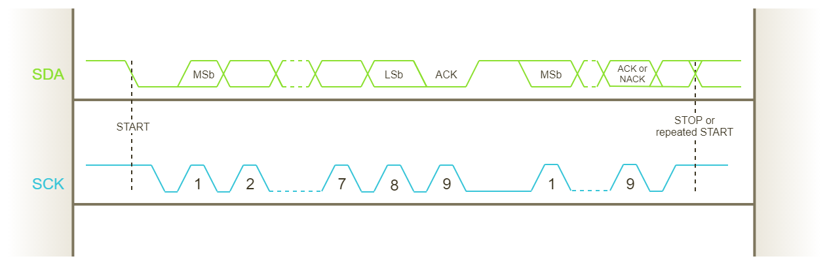
I2C: TIMING DIAGRAM
Notes:
Open drain (pull up) to avoid short circuits.
Each I2C transaction begins with a Start condition (SCL high and SDA moves from high to low) and ends with a Stop condition.
A transaction is composed by one or more messages where each message is 1 byte word (8-bit) plus an addition for synchronization: Acknowledge/Not acknowledge (ACK/NACK) bit.

Slide 15
CHIBIOS I2C DRIVER: INTRODUCTION
The ChibiOS I2C driver exploits the SPI cell capabilities to offer:
Master mode
A simple interface to use I2C through synchronous API only (with SPI we have asynchronous, too).
Each API of the I2C Driver starts with the prefix “i2c”. Function names are camel-case, pre-processor constants uppercase and variables lowercase.
The whole driver subsystem can be enabled through the proper switch in the halconf.h (HAL_USE_I2C).
To use the driver we have then to assign a I2C peripheral acting on mcuconf.h.
Assigning a peripheral to the driver a new object (I2CDx) will become available.
Each I2CDx object represent a driver which implements a Finite State Machine.

Slide 16
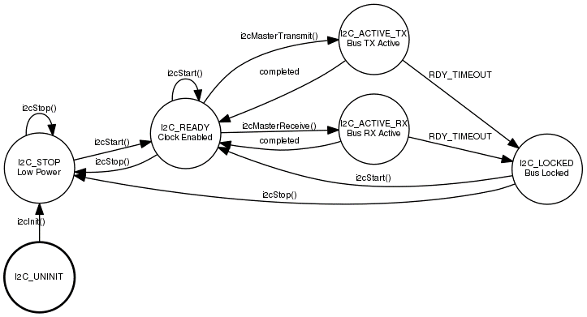
CHIBIOS I2C DRIVER: INTRODUCTION
A driver to be used shall be initialized but this is done automatically on halInit().
Each driver operation can be done only if driver has been properly started. This requires a call to i2cStart().
The i2cStart(&I2CD1, &i2ccfg) receives two parameters:
A pointer to the I2C driver object we want to start.
A pointer to a configuration structure.
If the driver is not used it can be stopped through the i2cStop().

Slide 17
CHIBIOS I2C DRIVER: CONFIGURATION
The I2C configuration structure has not any common field and all the configuration depends on hardware.
We have three hardware versions of I2C across all the various STM32 subfamilies.
The I2Cv1 exposes three parameters:
opmode, which is the operation mode (usually OPMODE_I2C, 1).
clock_speed, an integer representing the speed (100000 and 400000 allowed).
duty cycle, the duty mode which usually depends on speed.
The I2Cv2 and I2Cv3 expose three parameters:
timingr, TIMINGR register initialization.
cr1, CR1 register initialization.
cr2, CR2 register initialization.
These register offer a lot of flexibility but are very difficult to be configured.
It is suggested to copy configuration from a testhal demo for STM32 equipped with I2Cv2.
Notes:
The communication baud rate is adjustable according to some well specified values (Standard and fast mode).

Slide 18
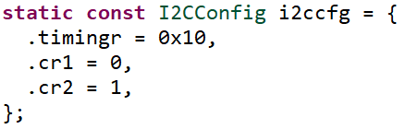
CHIBIOS I2C DRIVER: I2Cv2

Slide 19
CHIBIOS I2C DRIVER: API
The I2C communication from the master point of view can be synthesized in these steps:
The master send the first word with slave address and R/W bit.
The master send the second word with the SUB he wants to read/write.
The master send/receives n-words.
All those actions can be simply addressed with a single API with seven parameters:
i2cMasterTransmitTimeout(i2cp, addr, txbuf, txbytes, rxbuf, rxbytes, timeout)
the pointer to the I2C driver which shall be already started.
the SAD (Slave ADdress) having 7-bit lenght non shifted (without the R/W).
a pointer to a transmission buffer (can be NULL).
the number of word to transmit (can be 0).
a pointer to a reception buffer (can be NULL).
the number of word to receive (can be 0).
an operation timeout expressed as interval useful to avoid to be stuck in this fuction.
Notes:
If we want to write only we can set rxbuf to NULL and rxbytes to 0.
Timeout can be disabled choosing TIME_INFINITE or using the macros
The driver offers also a couple of API to acquire and release the bus: i2cAcquireBus and i2cReleaseBus (mutex).

Slide 20
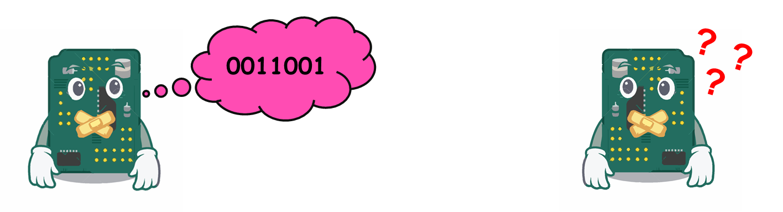
SPI vs I2C
SPI
I2C
Very fast (10 Mbps)
Master-Slave architecture
Better noise tolerance
Slower (3.4 Mbps MAX)
Multi-Master architecture
Less wires (2 wires needed)
Convenient if you need to link a lot of devices
In conclusion each bus has its own advantages and drawbacks. You should decide which bus is most suited for your requirements and for your needs.
Notes:
I2c level sensitive (high o low) the slower the better for noise reduction

Slide 21
Any questions?
Raise your hand or write in the chat.

Slide 22
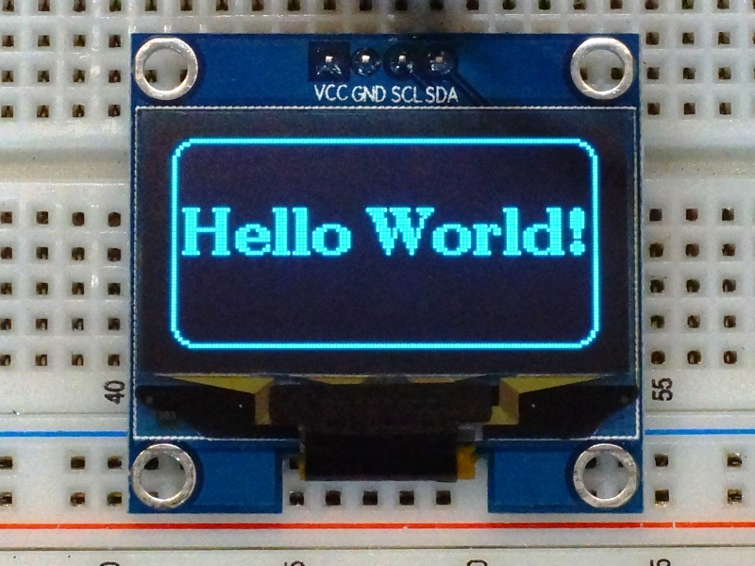
THE OLED DISPLAY
VCC
3.3 – 5 V
GND
SCL
SDA
OLED Display
128x64
SSD1306
Driver

Slide 23
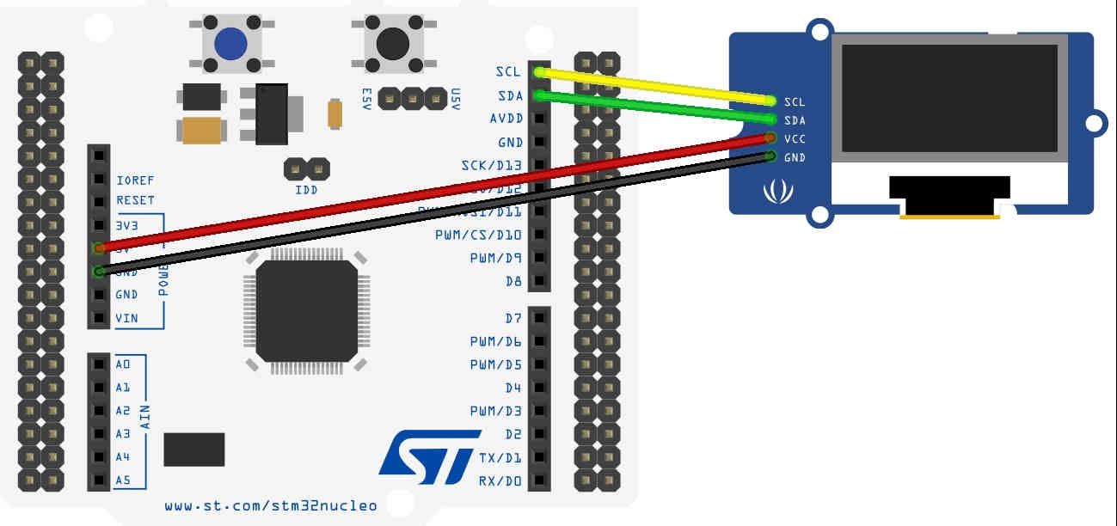
WIRING
You MUST power the Oled Display using 3.3V, as the performance of the display won’t be affected, but its longevity will increase.

Slide 24
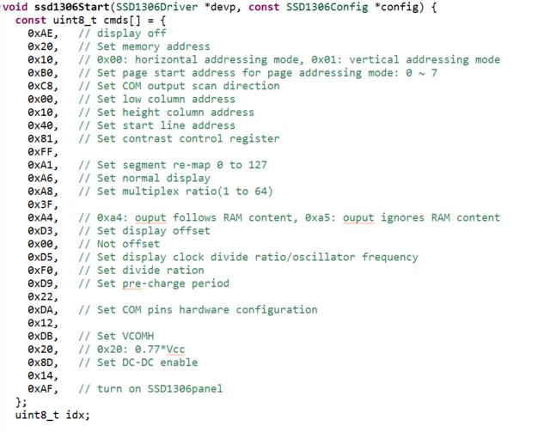
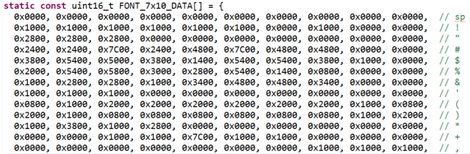
CODING
Files required:
Font files (it contains all the information needed to reproduce a single letter/number on the display).
Library files (it contains all the macros and the low-level instructions used to drive the display).
You can find all the files on the SVN Repository, under the ssd1306 folder. There is a project ready to be studied.
ssd1306_font.c
ssd1306.c

Slide 25
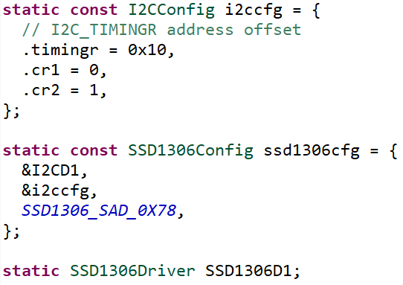
HOW TO CONFIGURE IT?
I2C Configuration structure
Display Configuration structure
*I2C Driver
*I2C Configuration structure
I2C Device address
Driver definition

Slide 26
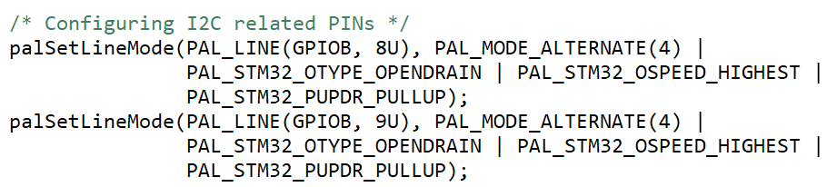
HOW TO CONFIGURE IT?
Notes:
STM32-specific I/O mode flags (HAL_PAL_LLD)
MACRO

Slide 27
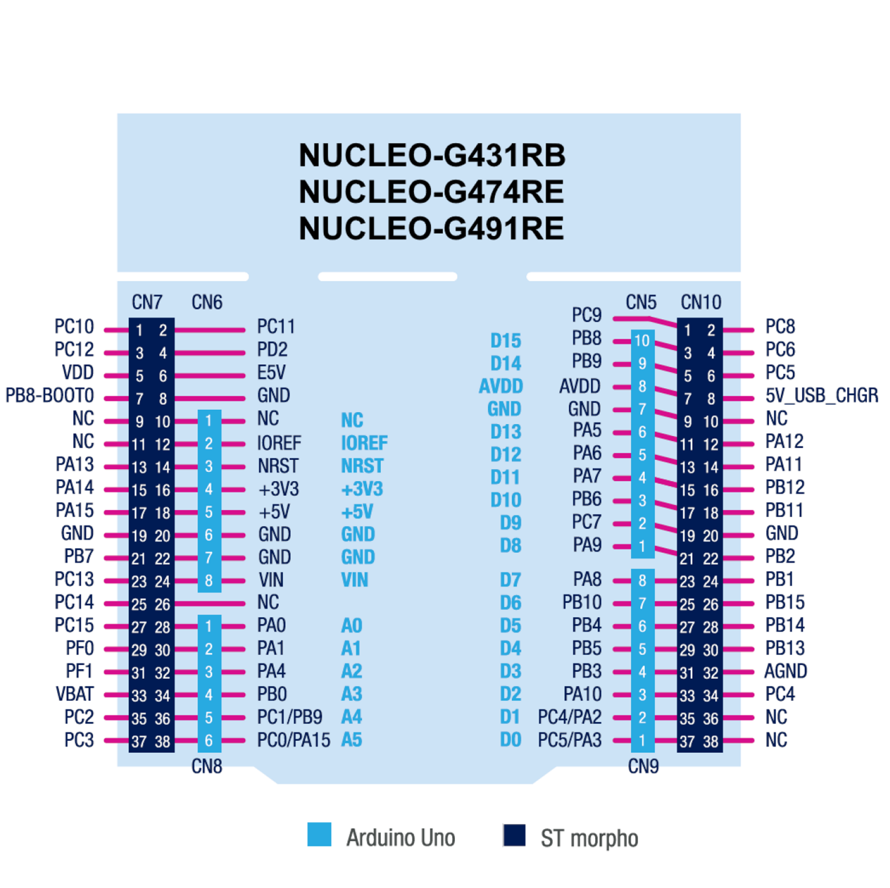
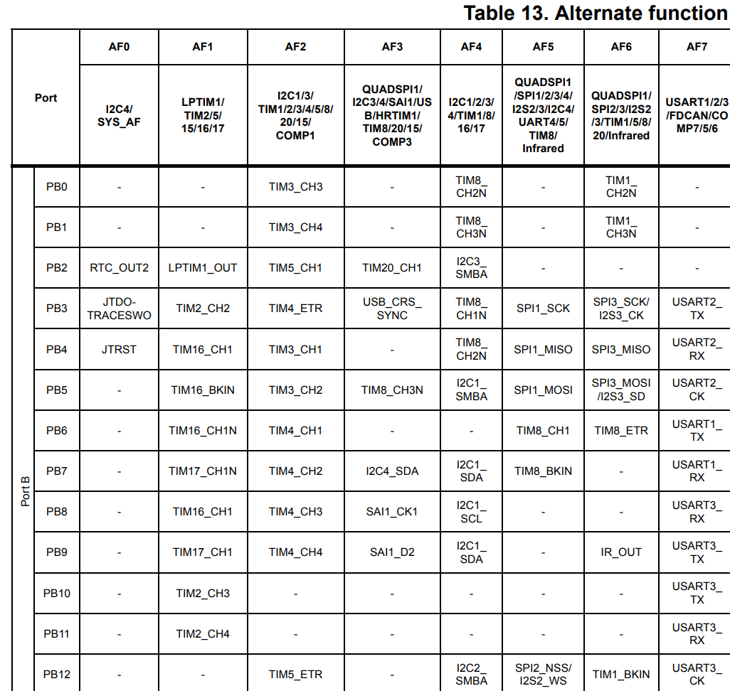
HOW TO CONFIGURE IT?
Table 13, page 74, STM32G474xE Datasheet.

Slide 28
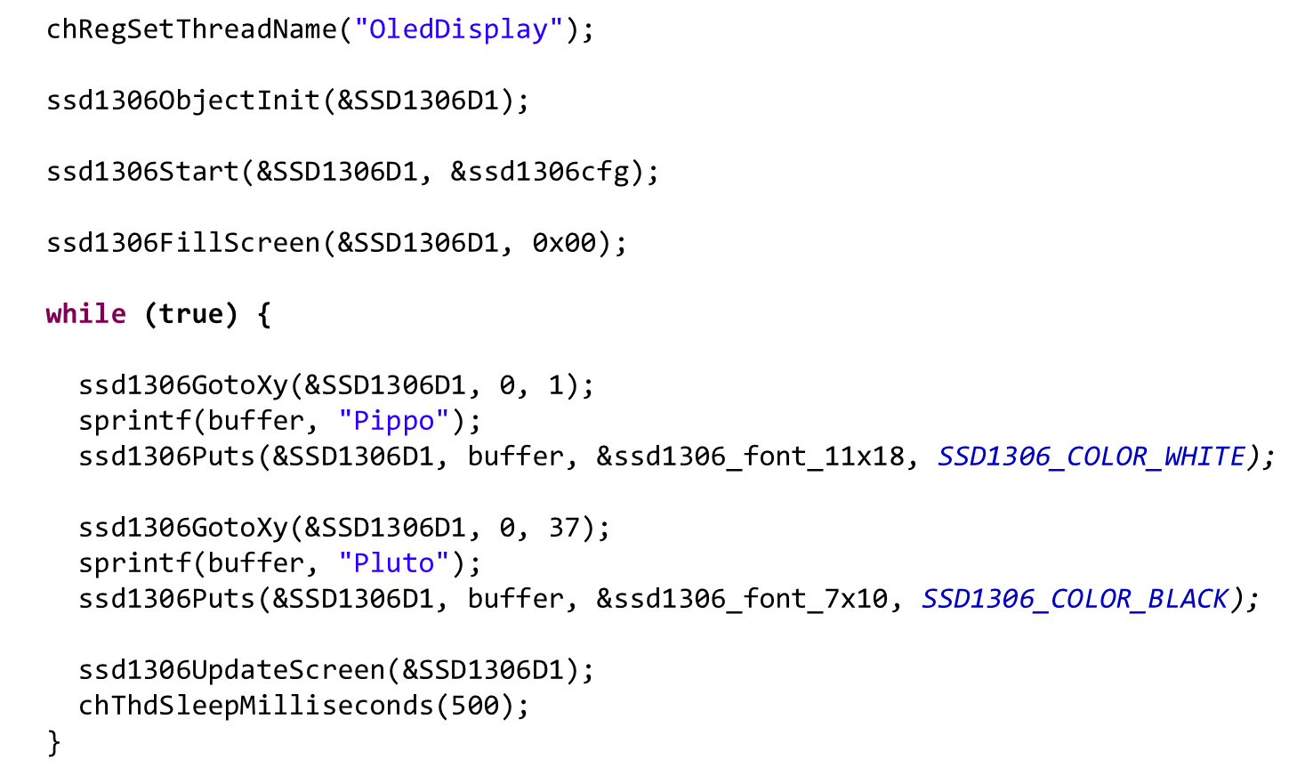
HOW TO USE IT?
Pippo
Pluto
Notes:
char buffer[20];

Slide 29
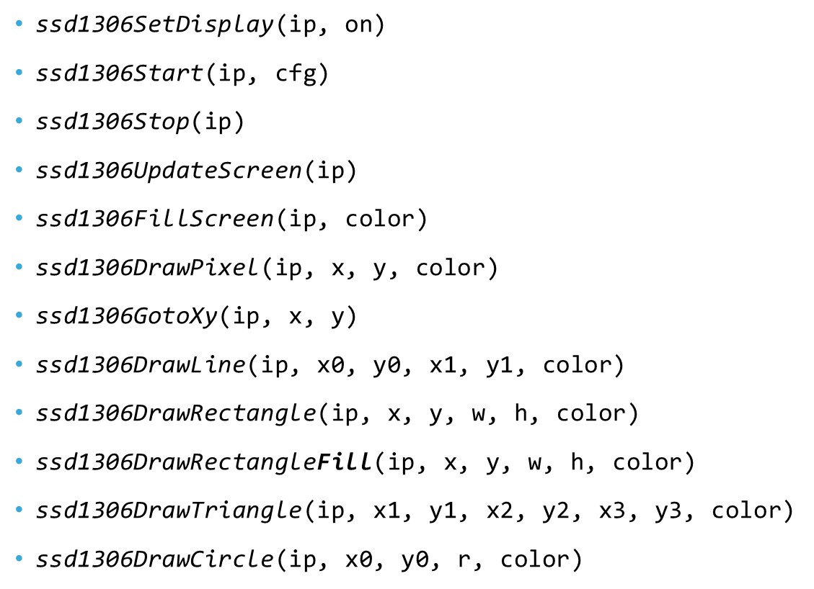
LIBRARY FUNCTIONS
ip : Pointer to driver
cfg : Pointer to display configuration
color : Color selection (you could use macros like SSD1306_COLOR_WHITE)
x, y : Pixel position on grid
x0, y0 / x1, y1 : Start/end point of line
w, h : Width, height of rectangle
x1, y1 / x2, y2 / x3, y3 : Vertices of triangle
x0, y0 / r: Center of circle / radius of circle
You could fill the rectangle/triangle/circle by adding “Fill” in the function name as shown earlier.

Slide 30
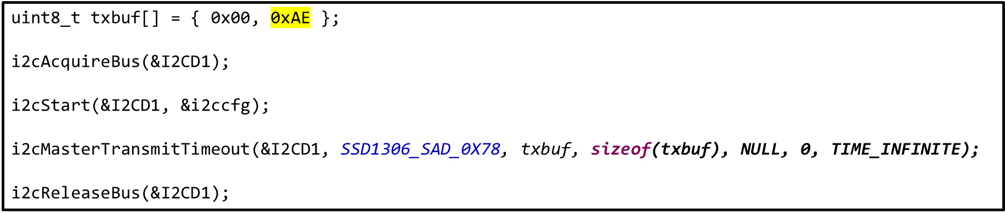
INSIGHTS
Where is all the i2c stuff? Embedded in the functions!
This is a simple code that lets us turn off the display.

Slide 31
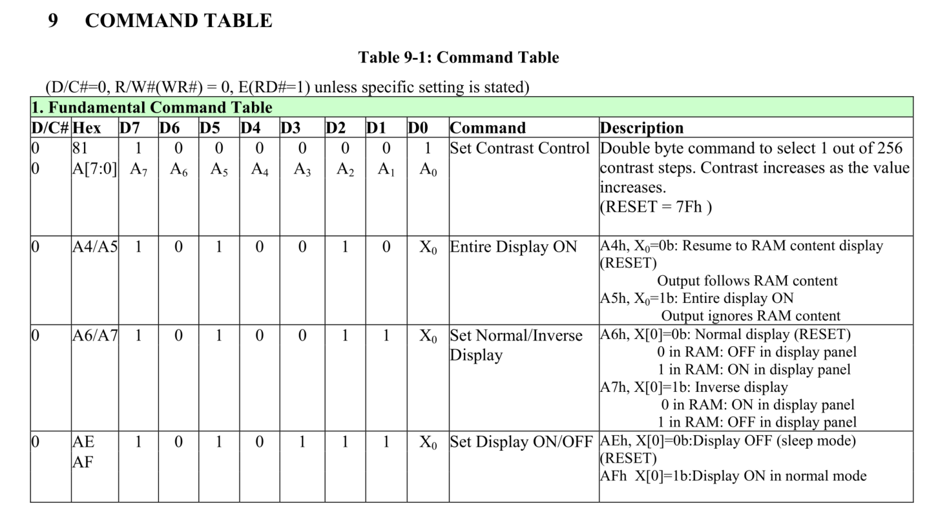
INSIGHTS
Table 9-1, page 28, SSD1306 Oled driver Datasheet.

Slide 32


Learn by doing
For more info read “Using STM32 SPI with ChibiOS” and “Using STM32 I2C with ChibiOS” on www.playembedded.org
SPI
I2C

